Slide 1
Data Analysis on COVID - 19
By Group 7 – Pratyush P, Priyanka Phadnis, Shreesha N and Varun Eranki

Slide 2
Introduction and Data
Coronavirus disease (COVID-19) is an infectious disease caused by a newly discovered coronavirus.
As of today, 3.06 million people in the world have been affected and 907,000+ people have recovered from the disease.
We gathered data for 88 attributes from 18 different sources like John Hopkins statistics, Google mobility reports, Global health data, Worldwide Demographics, Country – wise lockdown dates from Wikipedia etc.

Slide 3
Motivation
Through our analysis, we want to help the world by staying safe and take necessary precautions.
Showcase the effect of lockdown to prevent the disease.
Study on nucleotide and proteins of the virus to help researchers across the world.
Help the world speed up its recovery process.
Forecast the future and take effective measures to stop the disease from spreading even more.

Slide 4
Disclaimer
Content from this presentation is STRICTLY ONLY for educational and research purposes and may contain errors. The model and data are inaccurate to the complex, evolving, and heterogeneous realities of different countries and are not directed towards any person, group, nationality or ethnicity. Predictions are uncertain by nature and are impressions of what the data reflects. Readers must take any predictions with caution. Overly optimism based on some predicted end dates is dangerous because it may loosen our disciplines and controls and cause the turnaround of the virus and must be avoided.

Slide 5
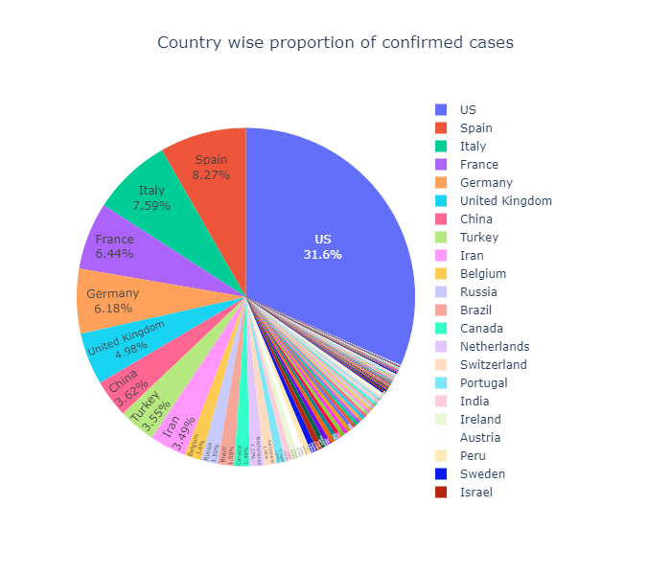
Some quick stats
US counts for the highest number of cases in confirmed cases, followed by Spain, Italy and France

Slide 6
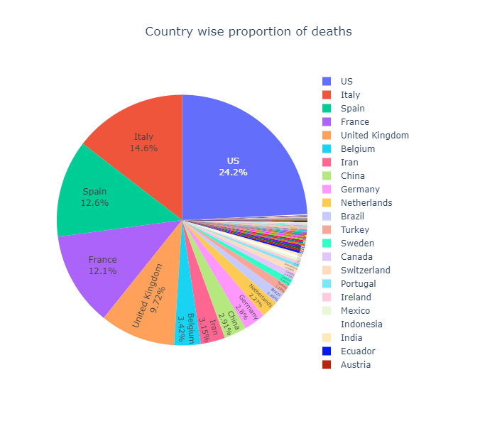
Country Wise Deaths
US accounts for 24.2% of deaths
Followed by Italy, Spain and France.

Slide 7
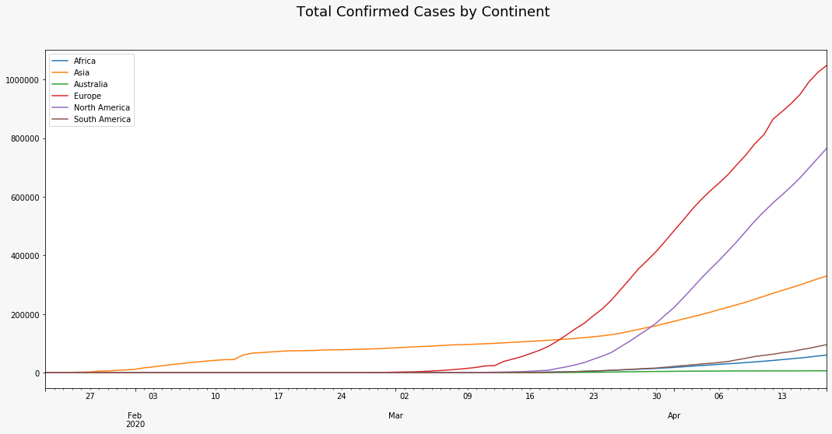
Confirmed cases by continent

Slide 8
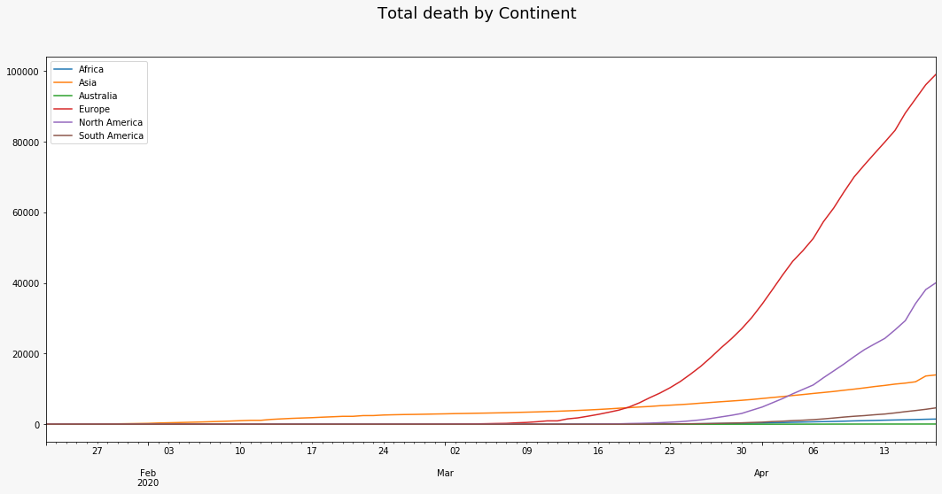
Deaths by continent

Slide 9
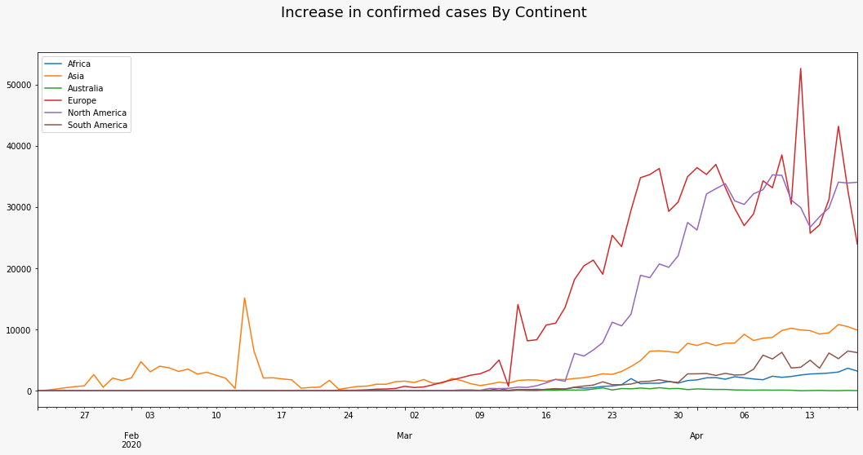
Increase in Confirmed cases by Continent

Slide 10
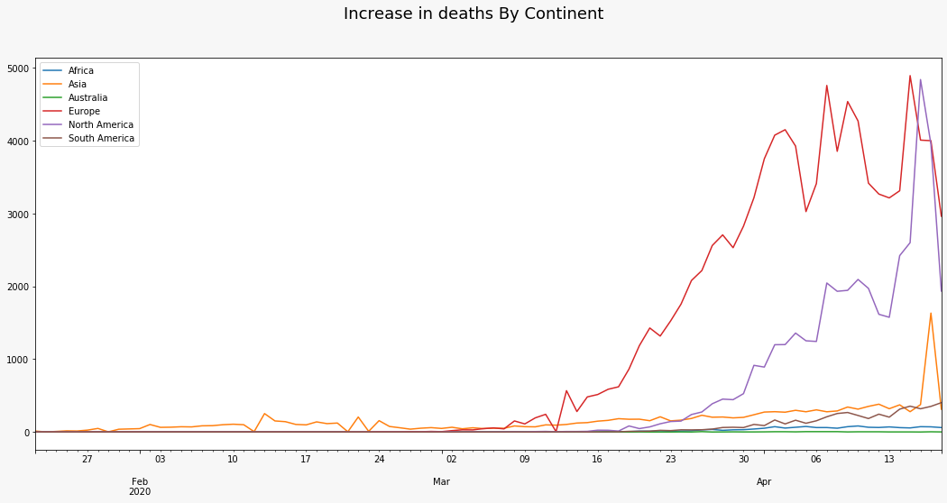
Increase in deaths by continent

Slide 11
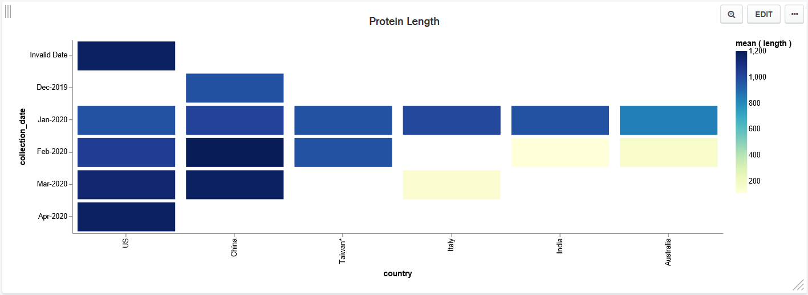
Protein Length

Slide 12

Deriving R0
R0, pronounced “R naught,” is a mathematical term that indicates how contagious an infectious disease is.
It’s also referred to as the reproduction number.
a controls how steep the curve will be and represents R0
The b value controls how left or right the exponential shifts.
Values of a and b are discovered by use of Gradient Descent and MSE as objective function

Slide 13
Forecasting Model: Problem Statement
Given today's date, How safe is a person living in United States ?
What are the person's chances of being infected by Covid19, given the person violates lockdown ?
Let's see !!

Slide 14
Forecasting Model: Heuristics
Data used
90 days of confirmed cases for training, county wise.
14 county static variables
Problem Type
Regression
Model used
RandomForestRegressor, trained with MAE loss
Results
R2: 92%
CV test error: 4.94

Slide 15
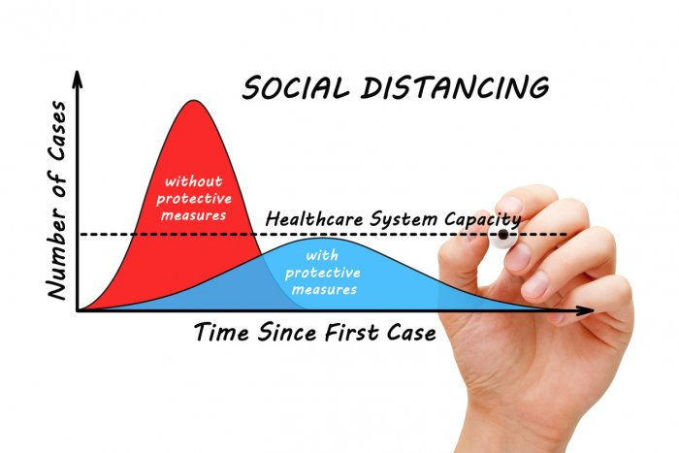
Predicting country – wise lockdown dates to flatten the curve
https://www.deccanherald.com/national/lockdown-may-help-flatten-covid-19-curve-in-india-says-study-820401.html

Slide 16
Data
Country wide lockdown dates of 51 countries from Wikipedia
Google’s Mobility reports of these 51 countries
Retail stores
Grocery stores
Parks
Transit stations
Workplaces
Residential areas
Country wise statistics from John Hopkins’ website
Data date range: 22nd January 2020 to 18th April 2020

Slide 17
Google’s Mobility Reports Explained
Baseline - Daily Average of 2019’s mobility records = 0
> 0 means increase in mobility to / within those areas
< 0 means decrease in mobility to / within those areas
Different areas recorded
Retail stores
Grocery stores
Parks
Transit stations
Workplaces
Residential areas

Slide 18
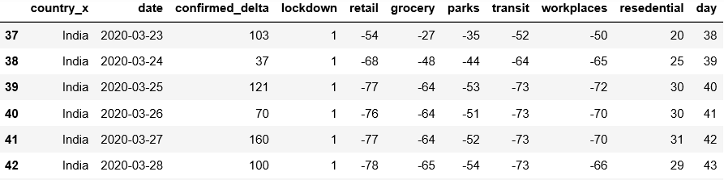
Pre-processing
Each country’s data is a separate dataset
Dropped unwanted columns
Total cases
Recoveries
Deaths, etc.
Changed format
‘date’ from string to
datetime object
New variables
‘day’
‘lockdown’
Joined both tables on ‘date’ feature

Slide 19
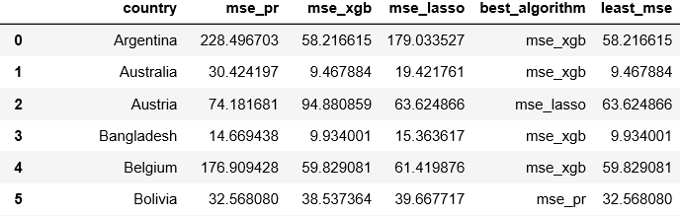
Modelling
3 regression models
Polynomial regression (degree = 2)
XGBoost Regressor
Lasso Regression
Accuracy metric: Mean Squared Error
5-fold cross validation

Slide 20
Best Algorithm by country breakdown
Algorithm | Number of Countries | Average MSE
Polynomial Regression (degree = 2) | 14 | 38.36
Lasso Regression | 11 | 34.62
XGBoost Regressor | 26 | 41.48

Slide 21
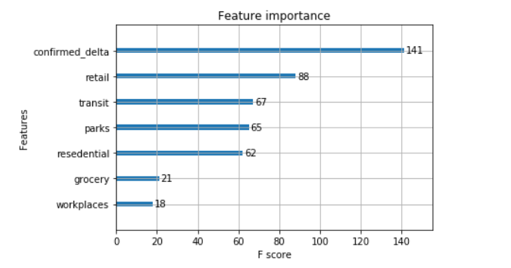
Feature Importance for XGBoost Regressor
Australia’s Feature Importance plot

Slide 22
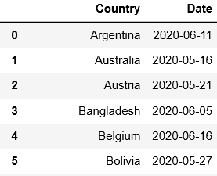
Results and Limitations
Lockdown dates predicted for every country to flatten the curve
Will be true only if present lockdown rules are not relaxed
Public must adhere to social distancing norms as followed on 18th April 2020 (last day in dataset)

Slide 23
Topics applied from the course
One hot encoding
Supervised Learning
Regression
Random Forrest Regressor
Polynomial Regression
XGBoost Regressor
Lasso Regression
Gradient Descent Optimization
Accuracy metrics: Mean squared error, Mean Absolute error, R-squared
K-fold cross validation
Feature Importance

Slide 24
Thank you!
Any questions ?

